Slide 1

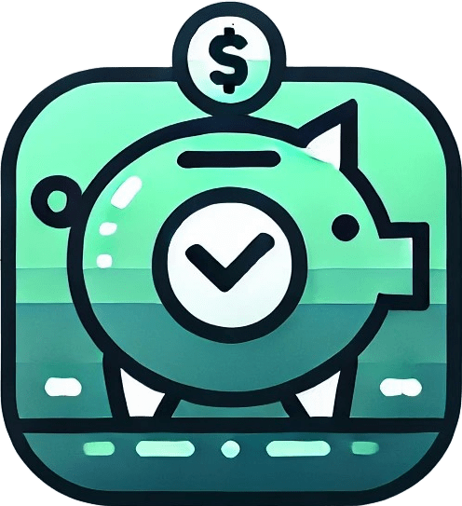
Smart Budget
Made by Edward Pratt and Sandy Hay

Slide 2



Topics
Introduction
Analysis
Design
Code & Testing
Conclusion

Slide 3

Introduction
This is our submission attempt for this terms’ Hackathon, where we create a website where we can help monitor and assist with people’s spending budgets, and provide financial insight.

Slide 4

Analysis
THE IDEAS AND CONCEPTS FOR THE PROJECT

Slide 5
The Purpose of this Project
What is the purpose of this project?
The analysis phase for a smart budgeting system focuses on understanding user financial behaviour, identifying spending patterns, and providing actionable insights to improve money management.
This involves collecting and processing data related to income, expenses, savings, and debts while categorizing transactions to identify trends and irregularities.

Slide 6
The Purpose of this Project
What Exactly are we looking for?
This project seeks to answer critical questions for the users such as:
What are the user’s major expense categories (e.g., food, rent, subscriptions)?
Are there opportunities to reduce unnecessary spending?
Is the user consistently saving money or living paycheck to paycheck (spending most or all their income, leaving no more for savings)?
How closely does the user follow their budget plan?

Slide 7
The Purpose of this Project
Our plan for the project
We chose to use React for the front-end development of our website. React, a popular JavaScript library, allowed us to create a dynamic and responsive user interface while taking advantage of its component-based architecture for reusable and modular code. JavaScript served as the primary language for implementing the front-end features.
For the back-end, we used Java, (Spring-boot) which is well-suited for building robust and scalable server-side applications. Java helped us handle server requests, manage data, and ensure smooth communication between the back-end and front-end through APIs. This combination allowed us to build a functional, efficient, and user-friendly website.

Slide 8

Design
THE DESIGN OF THE PROJECT

Slide 9
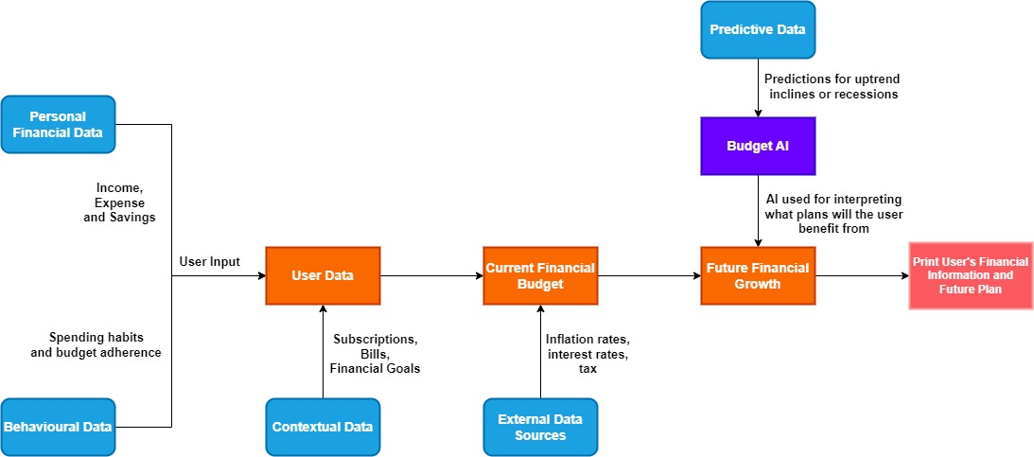
Diagram Design

Slide 10

Code & Testing
WHAT WE HAVE DONE

Slide 11
Reflection
FUTURE CONCEPTS AND IDEAS

Slide 12
Summary
So far in the 6 hours we’ve had, we have developed a website that can open subpages, where you are able to input your transactions and your savings, which they’ll be displayed in the respective tables and an Overview page where it displays how many months you will need to wait before you have enough for all of your savings.

Slide 13
Future Ideas
What are our future plans?
Implementing subscriptions into the website, and take it off from savings
Research and record inflation rates and interest rates
Generate an AI to predict the future growth of the user’s savings

Slide 14
Q&A

Slide 15


Thank You

